Slide 1
Testing and Test Approaches

Slide 2
Why testing is important
What are we testing?
Principles of testing
Test environments and phases
Data specific tests

Slide 3


Software systems are everywhere.
Minimise risk of software failure.
Impact of software failure.
Financial loss
Wasted time
Loss of reputation
Injury or death
… or have an insignificant effect.
Why Testing is Important

Slide 4
Functional
Requirements
Non-functional Requirements
What is being Tested?
(The ‘what’)
(The ‘how’)
What the system must do
Inputs
Outputs
Reports
Business rules
Compliance
Calculations
Transformations
Translations
Performance
Usability
Accessibility
Capacity
Maintainability
Reliability
Scalability
Availability
Flexibility
Security
Portability
Interoperability
Reusability

Slide 5


Verification
Validation
Validation vs Verification
The process of checking that the system has been built according to specification.
The process of checking that the systems meets the customer’s needs.

Slide 6
Psychology of Testing
Mindset of a Developer | Mindset of a Tester
The software is of acceptable quality | The software contains defects
It will work | It won’t work
Finding a defect is bad news | Finding a defect is good news
Short term view | Long term view
Testers are too negative | Developers are too optimistic
Positive view: look for what works | Negative view: look for what doesn’t work
Innocent until proven guilty | Guilty until proven innocent

Slide 7
Complete testing is not possible.
Complete assurance is not possible.
Testing work is creative and difficult.
An important reason for testing is to prevent errors from occurring.
Testing must be risk-based.
Testing must be planned.
Testing requires independence.
Principles of Testing

Slide 8
Testing Environments and Phases
Local Dev
Development (Dev)
System Integration Test (SIT)
User Acceptance Test (UAT)
Unit Testing
Integration Testing
System Integration Testing
User Acceptance Testing
Pre-Production (Pre-Prod)
Pre-Prod Testing
Production (Prod)
Live!

Slide 9
What is it?
Testing of individual software components.
Testing that a basic unit (module or program) of the system does as the specification says.
What may be tested?
Different logic routes through the code.
Objects and classes.
Modules or functions.
Stored procedures.
Data validation.
Who does it?
Programmer who developed the code.
Main source of tests?
Program specification.
User stories.
Unit Testing

Slide 10

What is it?
Testing performed to expose defects in the interfaces and interaction between components.
An interim level of testing between component testing and system testing.
Testing that data transfers correctly between internal parts of the system.
What may be tested?
Interfaces between modules, programs and sub-systems.
Who does it?
Usually developers.
Main sources of tests?
Detailed design.
Integration Testing

Slide 11

What is it?
The process of testing an integrated system to verify that it meets specified requirements.
Testing that the expected business outputs are correctly produced given the appropriate business inputs.
What may be tested?
Functionality of the system.
Exception conditions.
System documentation.
Technical aspects (see TAT).
Who does it?
System test team/independent test team.
Main sources of tests?
System design and requirements.
Functional specification.
System Integration Testing (SIT)

Slide 12

What is it?
Testing to provide the user with the confidence and assurance that the business system is ready for use.
Real world scenarios.
What is tested?
Computer procedures.
User procedures.
Data.
Who does it?
User staff (development team to provide support).
Main source of tests?
Requirements specification.
User Acceptance Testing (UAT)

Slide 13

What is it?
An opportunity to test the deployment of the new system in a ‘production like’ environment.
What is tested?
The deployment activities.
Any tasks, steps or jobs expected to operate before, during or after the new system processes.
Who does it?
IT operations.
Main source of tests?
Deployment schedule.
Technical specification.
Dependencies.
Impact on other systems.
Pre-Production Testing

Slide 14
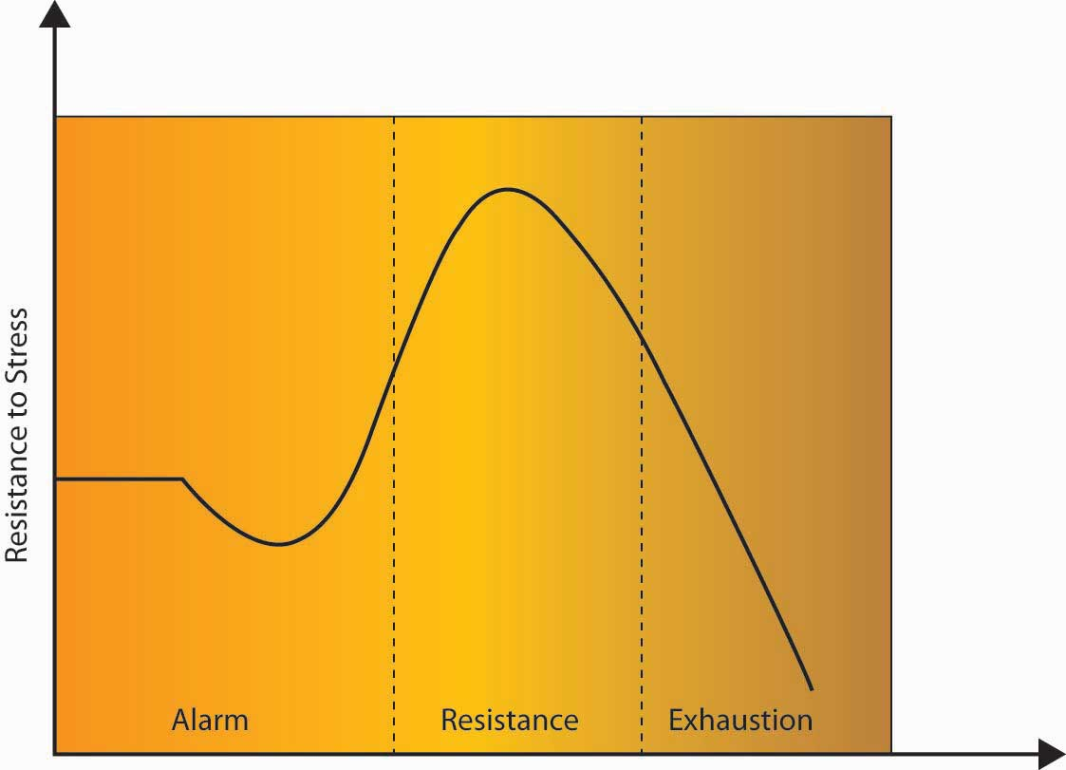
What is it?
Testing to assess speed and effectiveness of the system.
Testing under stress: what the system can cope with under extreme circumstances.
What is tested?
Response times.
Data volumes.
Number of users and concurrent processes.
Peak times of the day when may have to compete with other resources.
Who does it?
Technical teams.
Main source of tests?
Technical specification.
Non-functional requirements.
Performance Stress Testing (PST)

Slide 15
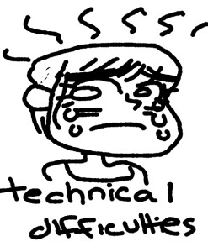
What is it?
Specific phase of testing where the design and application of tests requires some technical or specialist knowledge of the application or process being tested .
Not all software projects require this as a discrete stage – it’s typically only included as part of SIT or initial software evaluation.
What is tested?
Hardware compatibility.
Operating system compatibility.
Network compatibility.
System interoperability.
Who does it?
Technical teams.
Main source of tests?
Technical specification.
Non-functional requirements.
Technical Acceptance Testing (TAT)

Slide 16


Black Box vs White Box Testing
Takes into account the internal workings of a system.
Important if there are aspects of the ‘how’ that need to be tested.
Data flows
Decision points
Priority pathways
AKA Glass Box testing
Ignores the internal workings of the system and focuses on the outputs.
Are the outputs correct or not?
Form of functional testing.

Slide 17
Data Testing

Slide 18
Data Errors
Which data errors have we encountered as part of the case study implementation so far?

Slide 19
Incorrect data types as we move from source system to another system.
Missed columns from source to target.
Missed from mapping.
Overwriting by mapping multiple input columns to same output column.
Data Error
Examples
Truncation due to different column lengths.
Too many rows
Accidental appending.
Incorrect join.
Missing rows
Due to partial load.
Not handling nulls.
Incorrect join.
Incorrect presentation
Different codepages, character sets
Missing values
Not handling nulls.
Transform logic missed a condition in the data.
Incorrect calculations
Incorrect formula.
Incorrect data type.
Missing rows.
Missing columns.
Incorrect underlying values.
Incorrect values
Transform logic incorrect.
Source data mismatch.

Slide 20
Treat our data analysis work in the same way as delivering software code.
There will be bugs!
Data errors are often silent.
We want to deliver…
… with confidence.
… quality data products.
…with accuracy and correctness.
We want our numbers and findings to stack up.
Importance of Data Testing

Slide 21
Test Type | Description
User Requirements Testing (Front End) | Can we answer the questions (or run the reports) as specified in the requirements and get the desired result?
ETL Tests (Back End) | Does the ETL process run end to end without error? Does the ETL process generate the correct data results (see data tests)?
Data Tests (Back End) | Testing the data in the data model at varying levels (entity, record, column, value). Acts as a reconciliation and completeness check.
Data Quality (DQ) Tests | Are there DQ issues in source that need to be specifically handled (excluded/transformed)?
Performance Tests | According to the non-functional requirements: Does the ETL process run in acceptable timeframes? Do queries/reports run in acceptable timeframes?
Types of Tests on Data Projects

Slide 22
Entity/
Table
Are the entities in the requirements covered in the data model?
Can we query across tables to test relationships correctly?
Record
Does the table record count for each entity/table match source?
Column
Do we have all the columns we need from the source data?
Do we have the correct data types for each column?
Column Value
Do we have the correct range of values for each column?
For derived columns are the transformations correct?
Correctness of any additional ‘derived’ columns.
Do the counts per value match source?
Do we have uniqueness for each record (e.g. no duplicates)?
Is the granularity correct?
Levels of Data Tests

Slide 23
Case Study Task: Part 5 – Testing

